Slide 1
COURSE C++ 2 OOP 1, Git & CMake
By CSTUDIO

Slide 2
SUMMARY
Git
A distributed VCS
Save your changes in 3 steps
Branches & Pull Requests
More useful stuff
OOP
Classes and instances
Methods and attributes
Constructors
Visibility & Friendship
Inheritance & Masking
Compilation
Headers vs. Source
The preprocessor
CMake
Organize your source files with Cmake
Use dependencies

Slide 3
Git : a distributed VCS
Distributed ≠ Centralized : with Git everyone has the whole file history !
The server is only used to facilitate file sharing but is totally optional
You can use Git entirely in local, just by yourself ! It’s actually a great idea ^^

Slide 4
Git : Save your changes in 3 steps !
When you want to make changes to a file, you first have to add it to the index. Files not in the index are not tracked by Git.
When you have finished your changes on all the added files, you then commit them. Don’t forget to attach a message telling what the changes do!
Git is a distributed system, so for now everything is local to your computer. If you want other people to see your commits, you now have to push them.
If someone else on the project has made changes to the same parts of the files as you, the push will not work : you’ll have to choose which changes to keep.
If the changes were made to different parts of the files, Git will automatically merge them !

Slide 5
Git : Branches and Pull Requests
When you work as a team, you might want to separate the tasks. A great way to do it is to use Git branches for each of these.
When a new feature is ready, you can merge them in the master branch !
But merges can go both ways : if a new feature has appeared on another branch, and you want to have access to it in yours, you can merge the new feature’s branch directly into yours !
Big open-source projects do not allow people to create new branches and merge them directly in the master branch. Instead, you’ll have to clone / fork the project on your own account, make your changes, then publish a pull / merge request on the main project. Sometimes changes are rejected and the fork goes on to its own thing ! It’s the whole point of open-source ^^

Slide 6
Git : More useful stuff
You can jump from a branch to another thanks to the checkout command.
If you have made changes, before checking out, stash them.
Each commit has a checksum for identification : with them, you can directly checkout the associated commit, and even branch off of it ! You can also restore a project’s state to one of your earlier commits (Git will automatically delete the useless commits ahead after a push).
Git stores changes by diffs, so if you’re not happy with the organization of your commits, you can rebase them to move diffs to another commit. Make sure to well understand Git before doing that though !

Slide 7
Practise : Create your own repository
Go on gitlab.viarezo.fr and create a new project.
On your PC, use git clone to retrieve it.
Make a Hello World program, commit it and push it !
Then, your teammate has to pull it, modify it and push it again.
Also try to experiment with branches !

Slide 8
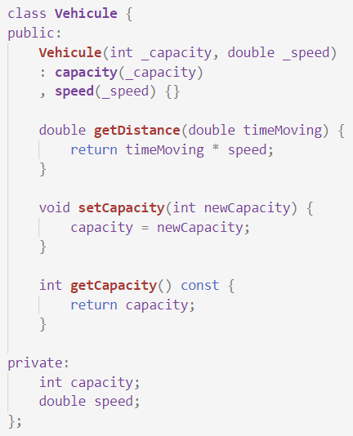
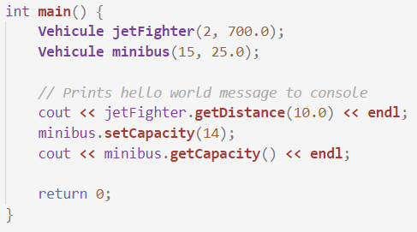
OOP : Classes & Instances
One class, two instances

Slide 9
OOP : Methods & Attributes
Methods are functions that apply to an instance of a class. They are at the top here :
getDistance
setCapacity
getCapacity
Attributes are the variables the compose a class. Each instance has its own copy of the class’s attributes. Here they are at the bottom :
capacity
speed

Slide 10
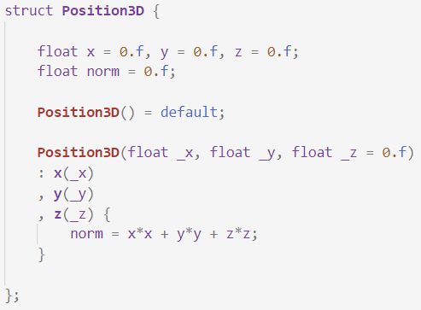
OOP : Constructors
One of the special functions a class can have is a constructor : it represents the instructions to build a new instance.
The function signature is always the name of the class, without return type. You can have the arguments you want.
After the signature, there is the initializer list : each attribute’s constructor is called before entering the constructor’s body.
You can explicitely enable the default constructor when you create a custom one, as it is disabled by default.
You can also specify default values for the attributes, so you won’t have to explicitely set them for each constructor. Do not abuse this, though !

Slide 11
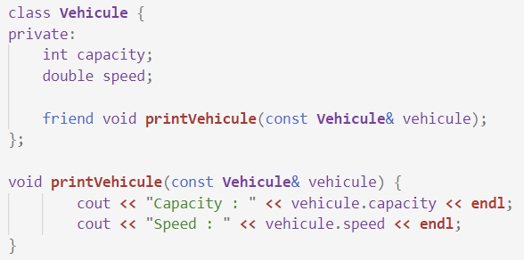
OOP : Friendship
Friendship is used to control who you allow access to fields of your class.
For example, if you only need to print the info of your Vehicule, you can keep the fields private, but make the printing function a friend of the class !

Slide 12
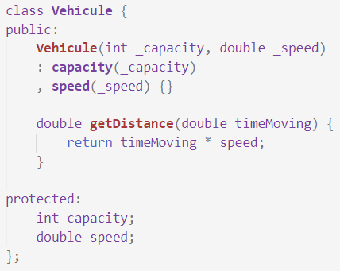
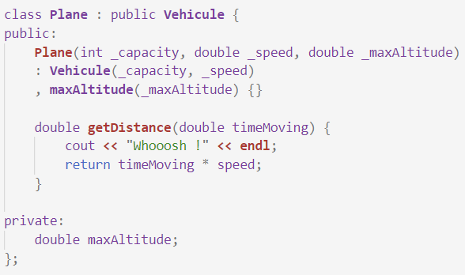
OOP : Inheritance, Masking & Protected
Inheritance is a relation between classes, meaning here « a plane is a kind of vehicule ».
Inherited classes automatically keep all methods and attributes from parents. If they want, to customize a parent method, they can mask it.
We have to change the Vehicule attributes’ visibility : if it remained private, even the child class Plane wouldn’t have has access to them. We use the protected visibility for that.

Slide 13
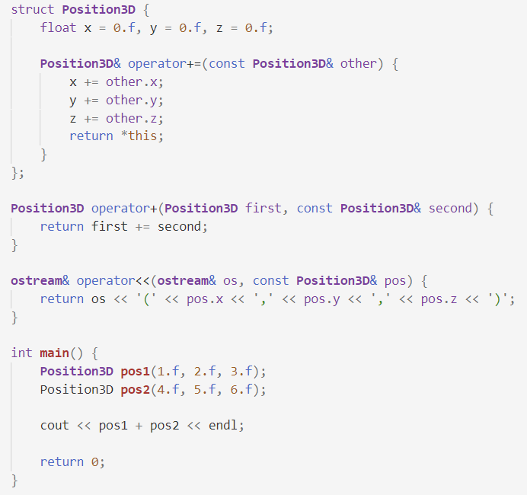
OOP : Operator Overloading

Slide 14
Practise : Calendar & Contacts
Make a calendar app ! You must be able to add appointments with a name, a description and a date.
Make a contact list app ! Contacts have a name, a telephone number, an email address and a place of living.
Don’t forget to use Git for your creations !

Slide 15
Compilation : Headers vs source
You can split your code in multiple files !
In C++, there are two types of files : the header files and the source files.
Source files contain the functions’ code : their definitions.
Header files contain the functions’ forward declarations and the classes definitions.
Source files do not know of the existence of the other source files : for one part of the code to acknowledge another part’s existence, we have to include the other part’s header.

Slide 16
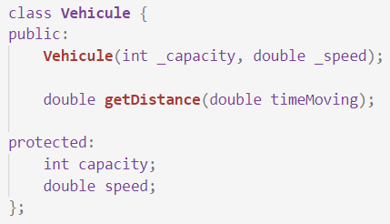
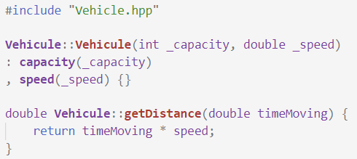
Compilation : Headers vs source

Slide 17
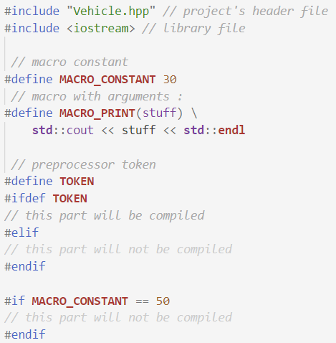
Compilation : The preprocessor

Slide 18
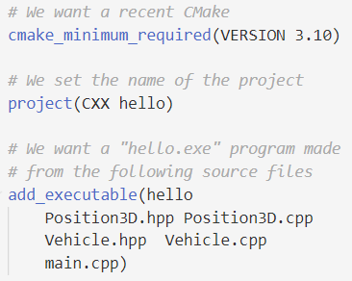
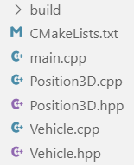
Cmake : Organize your source files !

